Slide 1
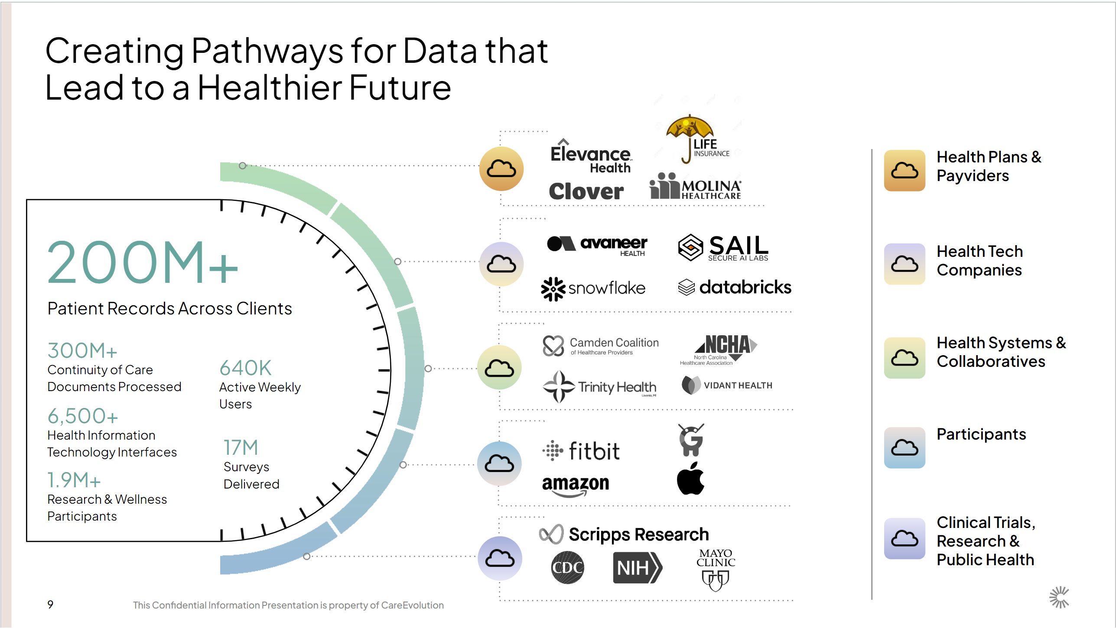

Slide 2
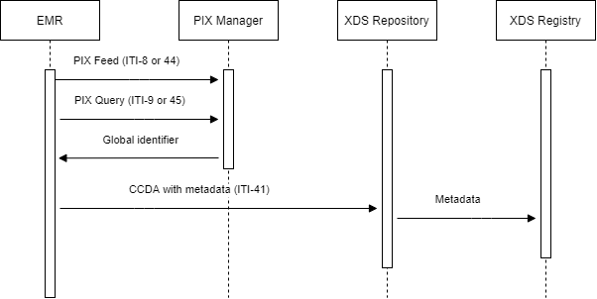
PIX-XDS

Slide 3
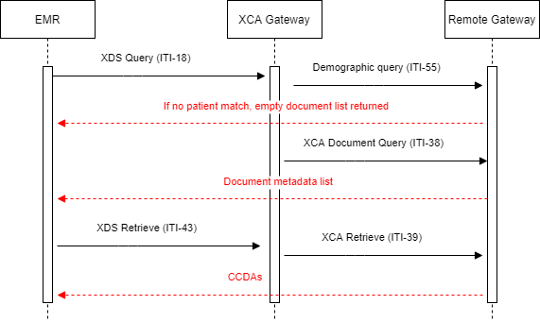
XCA-XCPD

Slide 4
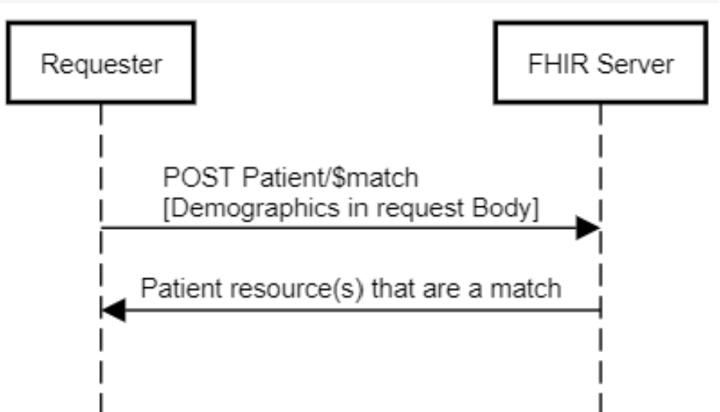
FHIR Patient/$match

Slide 5
False Positive vs False Negative match risks
False Negative (did not match two records representing the same person)
Data visibility gaps – missing a slice of patient history
Duplicate search results – patient search shows two rows
Patient frustration – patient needs to repeat their history during interactions
False Positive (matched two different persons into one)
Privacy violation – disclosure of sensitive data on wrong individual
Medical Errors – risk of harm to the patient - prescribing medications based on wrong information, performing procedures based on wrong information

Slide 6
State of the industry
“A 2014 report from the Office of the National Coordinator for Health Information Technology (ONC) found that 7 out of every 100 patient records are mismatched. Worse still, the error rate is typically closer to 10% to 20% within a healthcare entity, and it rises to 50% to 60% when entities exchange with each other.”
“In a 2012 CHIME study, 20% of CHIME members could trace an adverse medical event to problems with patient identification and/or patient matching.”
OCHIN works with more than 500 healthcare providers in 47 states. Among its patient population, 13% of patients are Black but represent 21% of mismatched records. While 21% of the patient population is Hispanic, 35% of those patients have been misidentified. About 4% of OCHIN's patient population is homeless, but 12% of those patients have been misidentified, Sears said.
"Every mismatched or duplicate record puts two patients at risk—the person receiving care and the person who was inaccurately mismatched with that patient. This can lead to patients receiving the wrong care, the wrong patient history, the wrong testing, and drug-drug interactions”
https://www.fiercehealthcare.com/tech/groups-urge-congress-to-take-action-patient-identifier-as-covid-19-raises-stakes

Slide 7
Not as unique as you think
First name + Last name + DOB
Some names are very common (e.g. James Smith, William Miller, Brian Johnson) and some of those people share a DOB ¹
Names and DOB are not independent. (e.g. Carol and Noel born on 12/25, Katrina born on 8/25/2009) ²
First name + Last name + DOB + Zip
Not always independent (e.g. 50% of South Koreans have a last name of Kim, Park or Lee. Some zip codes represent an ethnic enclave and have a large South Korean population) ³
First name + DOB + Contact Point (address/phone)
Not every address/phone is a single family household. (e.g. SNF, Rehab center, homeless shelter)
Last name + DOB + Contact Point (address/phone)
Twins (e.g. Janette and Anette born on 1/2/2015 living at the same address)
Many approaches to algorithmically improve “match rates” (loose handling of first/last swaps, DOB transpositions, soundex names, typos) may dramatically increase the opportunity for “collisions”
https://www.healthit.gov/sites/default/files/patient-matching-white-paper-final-2.pdf
https://www.americannamesociety.org/about-names-hurricanes-can-cause-a-brief-rise-in-a-names-popularity-then-a-drop/
https://forebears.io/south-korea/surnames

Slide 8


High quality patient matching requires high quality demographics
Supplied Demographics |  | Match Quality
First/Last/Gender/DOB | While it may seem unlikely for two individuals to share exactly the same first and last name, date of birth, and gender, it actually happens with some frequency.
First/Last/Gender/DOB Non-specific identifier (e.g. Zip) | As in the previous case, name/gender/DOB is not sufficient for a match. Broad geographic bounding is not helpful as names/geography are not independent.
First/Last/Gender/DOB MRN | MRN sometimes helps within a single facility but is not shared broadly. Not very useful for matching across sources.
First/Last/Gender/DOB Contact Info (full address and/or phone) | Works well with certain caveats. People move and addresses are not always updated in all systems. Requires care in typo/transposition/name change handling as being too loose risks false matches in communal living facilities (SNF, Homeless Shelter), or similar named twins.
First/Last/Gender/DOB Government/Insurance IDs (SSN/Health Card/Medicaid) | Works very well. The combination of specific identifiers allows greater sensitivity to typos/transpositions in names.
First/Last/Gender/DOB Government/Insurance IDs Contact Info | Works excellent. The full combination of fields achieves excellent specificity while handling common issues such as changes in address and common transpositions/errors.

